Slide 1
Dilations

Slide 2

Warm Up
Write each fraction in simplest form.
1. $\frac{15}{81}$
2. $\frac{36}{216}$
3. $\frac{95}{240}$
4. $\frac{51}{540}$
5. $\frac{189}{300}$

Slide 3
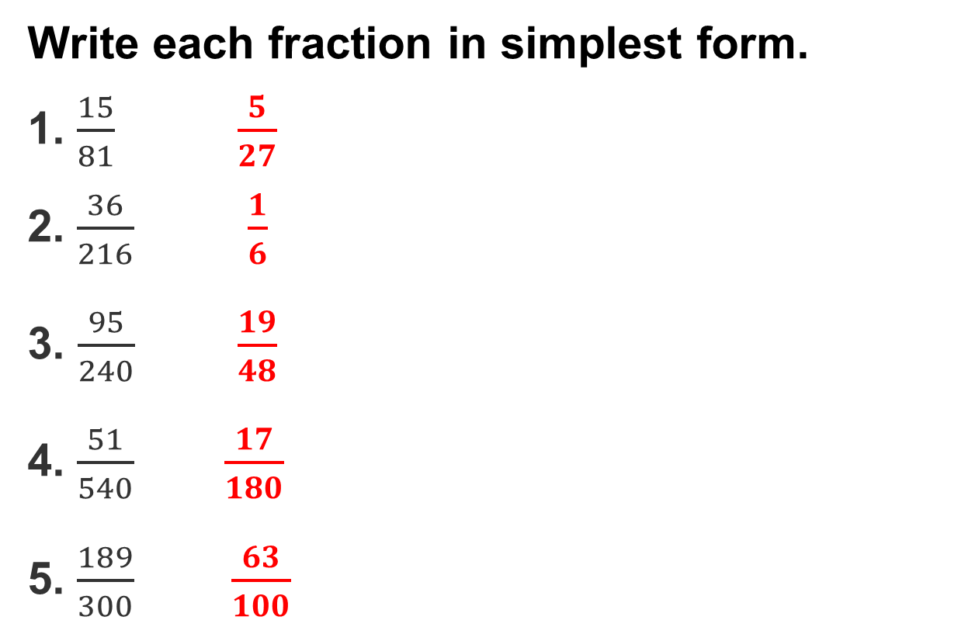
Warm Up
Write each fraction in simplest form.
1. $\frac{15}{81}$ $\frac{5}{27}$
2. $\frac{36}{216}$ $\frac{1}{6}$
3. $\frac{95}{240}$ $\frac{19}{48}$
4. $\frac{51}{540}$ $\frac{17}{180}$
5. $\frac{189}{300}$ $\frac{63}{100}$
Notes:
$\frac{5}{27}$
$\frac{1}{6}$
$\frac{19}{48}$
$\frac{17}{180}$
$\frac{63}{100}$

Slide 4
Learning objectives
● Use scale factors to calculate the dimensions of dilated images.
● Represent dilations as functions and find the scale factors of dilations.

Slide 5
Learn Dilations
A rigid motion moves a shape without changing its size or shape.
The original shape is the preimage. The new shape is the image.
A nonrigid transformation changes a shape’s size.
A dilation makes a shape bigger or smaller. The image has side lengths proportional to the original shape.

Slide 6
Dilations
The center of dilation is the fixed point used to enlarge or reduce a shape.
The scale factor, usually written as k, tells how much the shape changes.
If k > 1, the image is bigger.
If 0 < k < 1, the image is smaller.

Slide 7
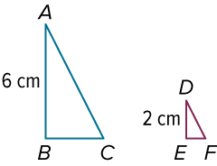
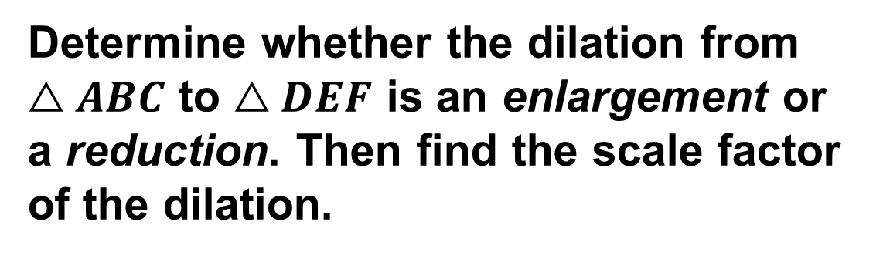
Identify a Dilation to Find Scale Factor
Determine whether the dilation from $△ABC$ to $△DEF$ is an enlargement or a reduction. Then find the scale factor of the dilation.

Slide 8
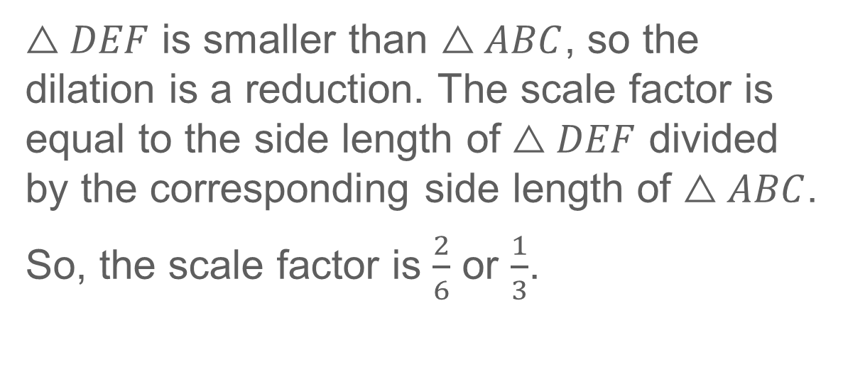
Identify a Dilation to Find Scale Factor
$△DEF$ is smaller than $△ABC$, so the dilation is a reduction. The scale factor is equal to the side length of $△DEF$ divided by the corresponding side length of $△ABC$.
So, the scale factor is $\frac{2}{6}$ or $\frac{1}{3}$.

Slide 9
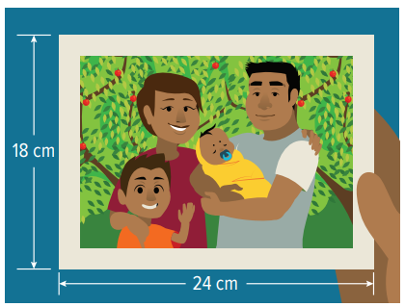
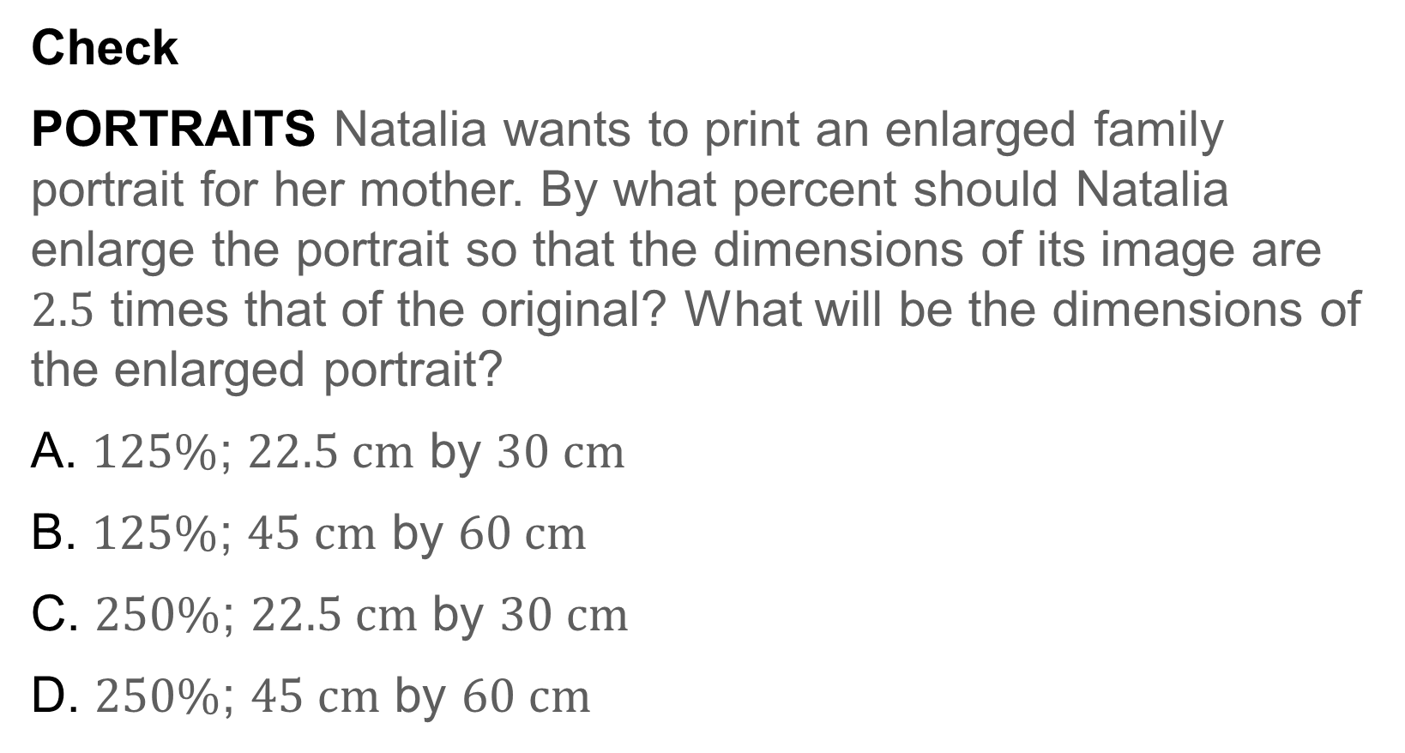
Find and Use a Scale Factor
Check
PORTRAITS Natalia wants to print an enlarged family portrait for her mother. By what percent should Natalia enlarge the portrait so that the dimensions of its image are $2.5$ times that of the original? What will be the dimensions of the enlarged portrait?
A. $125\%$; $22.5 cm$ by $30 cm$
B. $125\%$; $45 cm$ by $60 cm$
C. $250\%$; $22.5 cm$ by $30 cm$
D. $250\%$; $45 cm$ by $60 cm$

Slide 10
Example 2 Find and Use a Scale Factor
Check
PORTRAITS Natalia wants to print an enlarged family portrait for her mother. By what percent should Natalia enlarge the portrait so that the dimensions of its image are $2.5$ times that of the original? What will be the dimensions of the enlarged portrait?
A. $125\%$; $22.5 cm$ by $30 cm$
B. $125\%$; $45 cm$ by $60 cm$
C. $250\%$; $22.5 cm$ by $30 cm$
D. $250\%$; $45 cm$ by $60 cm$
Notes:
D. $250\%$; $45 cm$ by $60 cm$

Slide 11
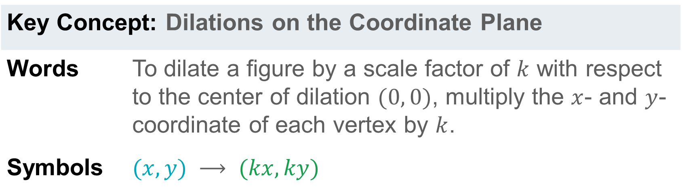
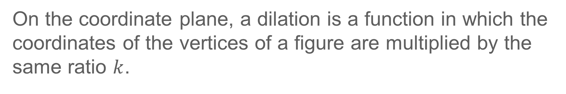
Learn Dilations on the Coordinate Plane
On the coordinate plane, a dilation is a function in which the coordinates of the vertices of a figure are multiplied by the same ratio $k$.
Key Concept: Dilations on the Coordinate Plane
Words | To dilate a figure by a scale factor of $k$ with respect to the center of dilation $(0, 0)$, multiply the $x$- and $y$-coordinate of each vertex by $k$.
Symbols | $$(x, y) ⟶ (kx, ky)$$

Slide 12
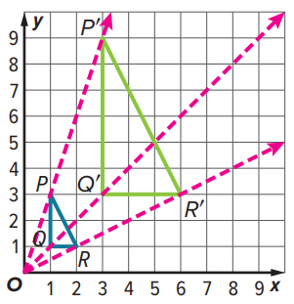
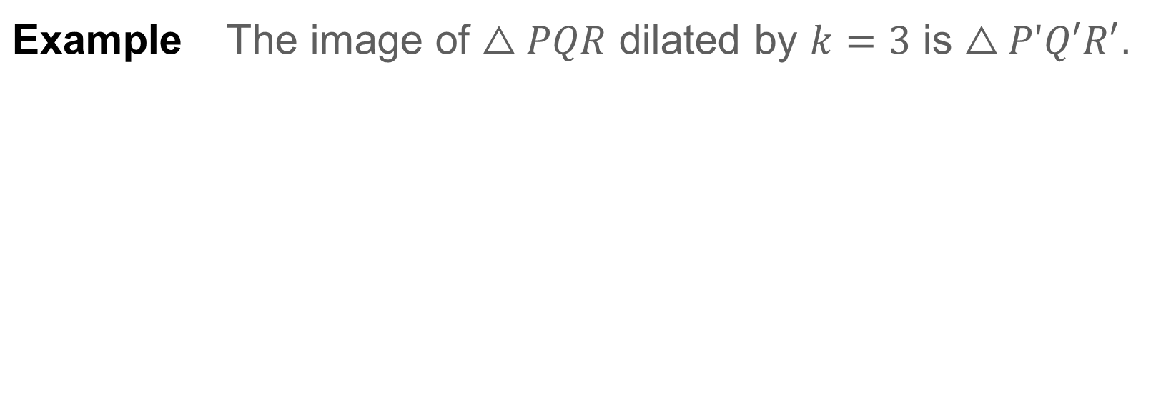
Learn Dilations on the Coordinate Plane
Example | The image of $△PQR$ dilated by $k=3$ is $△PʹQ′R′$.

Slide 13

Learn Dilations on the Coordinate Plane
Think About It!
What is the relationship between $PQ$ and $P′Q′$? How does this relate to the scale factor?

Slide 14
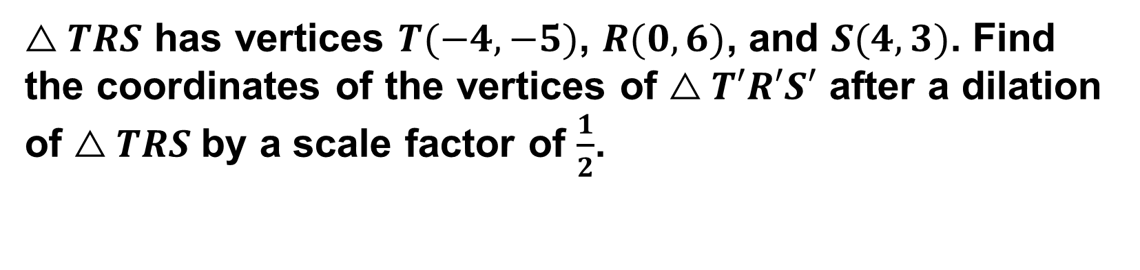
Example 3 Dilate a Figure
$△TRS$ has vertices $T(−4, −5)$, $R(0,6)$, and $S(4, 3)$. Find the coordinates of the vertices of $△T′R′S′$ after a dilation of $△TRS$by a scale factor of $\frac{1}{2}$.

Slide 15
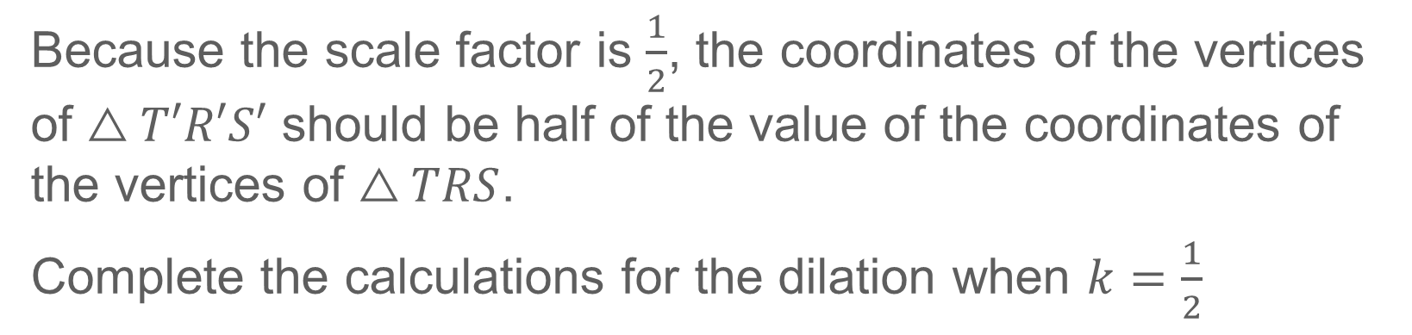
Example 3 Dilate a Figure
Because the scale factor is $\frac{1}{2}$, the coordinates of the vertices of $△T′R′S′$ should be half of the value of the coordinates of the vertices of $△TRS$.
Complete the calculations for the dilation when $k=\frac{1}{2}$

Slide 16
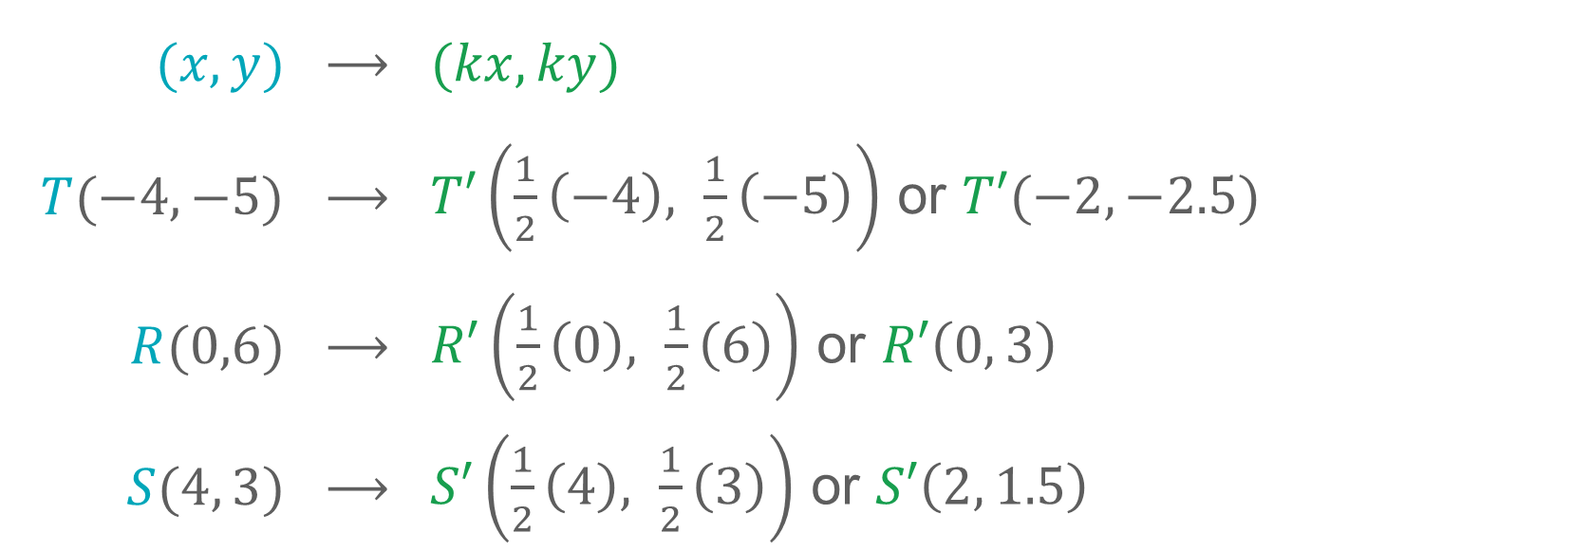
Example 3 Dilate a Figure
$$(x, y)$$ | ⟶ | $$(kx, ky)$$
$T(−4,−5)$ | ⟶ | $T′\left(\frac{1}{2}\left(−4\right), \frac{1}{2}\left(−5\right)\right)$ or $T′(−2, −2.5)$
$R(0,6)$ | ⟶ | $R′\left(\frac{1}{2}\left(0\right), \frac{1}{2}\left(6\right)\right)$ or $R′\left(0, 3\right)$
$S(4, 3)$ | ⟶ | $S′\left(\frac{1}{2}\left(4\right), \frac{1}{2}\left(3\right)\right)$ or $S′\left(2, 1.5\right)$

Slide 17
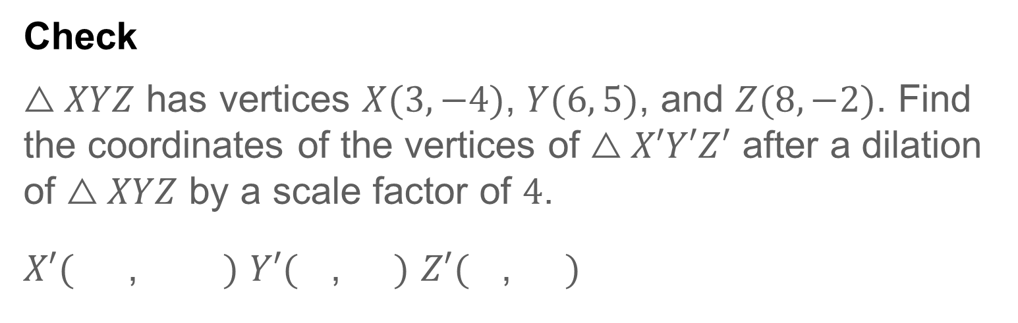
Example 3 Dilate a Figure
Check
$△XYZ$ has vertices $X(3, −4)$, $Y(6, 5)$, and $Z(8, −2)$. Find the coordinates of the vertices of $△X′Y′Z′$ after a dilation of $△XYZ$ by a scale factor of $4$.
$X′($ , $)$ $Y′($ , $)$ $Z′($ , $)$

Slide 18
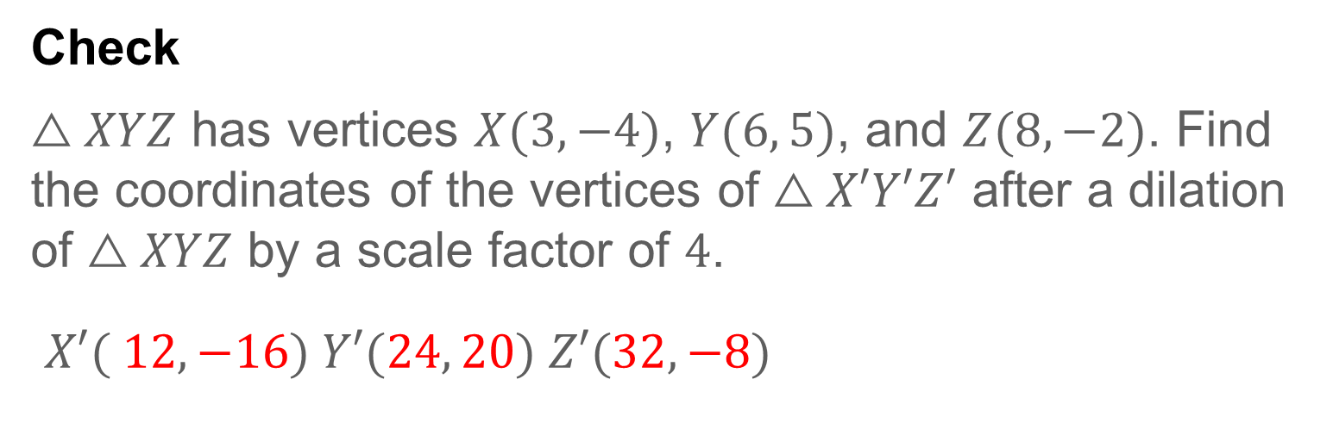
Example 3 Dilate a Figure
Check
$△XYZ$ has vertices $X(3, −4)$, $Y(6, 5)$, and $Z(8, −2)$. Find the coordinates of the vertices of $△X′Y′Z′$ after a dilation of $△XYZ$ by a scale factor of $4$.
$X′( 12, −16) Y′(24, 20) Z′(32, −8)$
Notes:
$$X′( 12, −16) Y′(24, 20) Z′(32, −8)$$

Slide 19
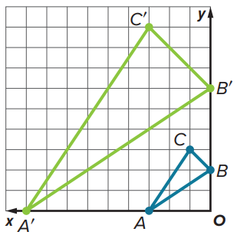
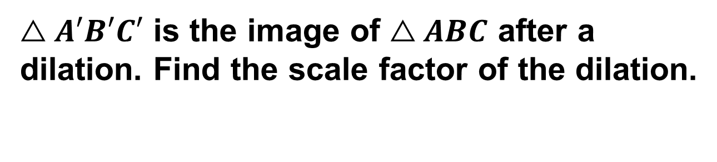
Example 4 Find the Scale Factor of a Dilation
$△A′B′C′$ is the image of $△ABC$ after a dilation. Find the scale factor of the dilation.

Slide 20
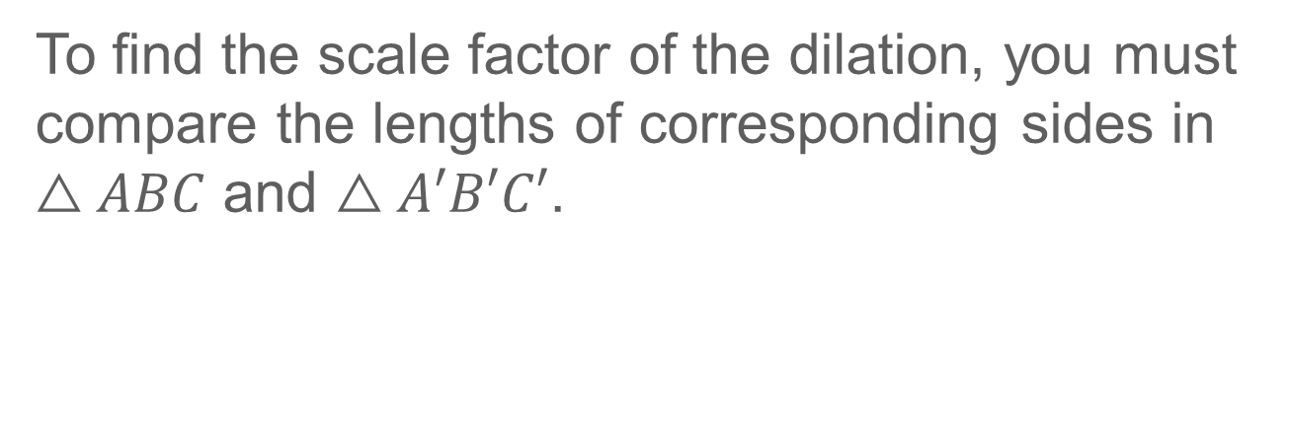
Example 4 Find the Scale Factor of a Dilation
To find the scale factor of the dilation, you must compare the lengths of corresponding sides in $△ABC$ and $△A′B′C′$.

Slide 21
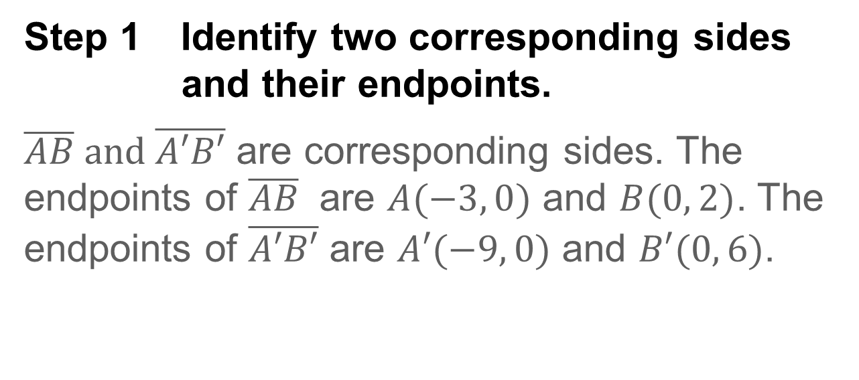
Example 4 Find the Scale Factor of a Dilation
Step 1 Identify two corresponding sides and their endpoints.
$\overline{AB} and \overline{A′B′}$ are corresponding sides. The endpoints of $\overline{AB}$ are $A(−3, 0)$ and $B(0, 2)$. The endpoints of $\overline{A′B′}$ are $A′(−9, 0)$ and $B′(0, 6)$.

Slide 22

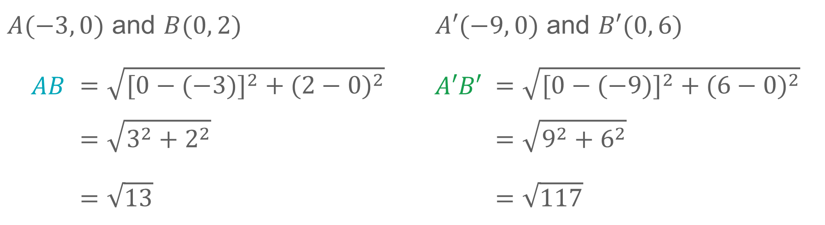
Example 4 Find the Scale Factor of a Dilation
Step 2 Find the lengths of the corresponding sides.
Use the Distance Formula to find $AB$ and $A′B′$.
$A(−3, 0)$ and $B(0, 2)$ |  | $A′(−9, 0)$ and $B′(0, 6)$
$AB$ | $$=\sqrt{{[0−(−3)]}^{2} + {(2−0)}^{2}}$$ | $A′B′$ | $$=\sqrt{{[0−(−9)]}^{2} + {(6−0)}^{2}}$$
 | $$=\sqrt{3^{2}+2^{2}}$$ |  | $$=\sqrt{9^{2}+6^{2}}$$
 | $$=\sqrt{13}$$ |  | $$=\sqrt{117}$$

Slide 23
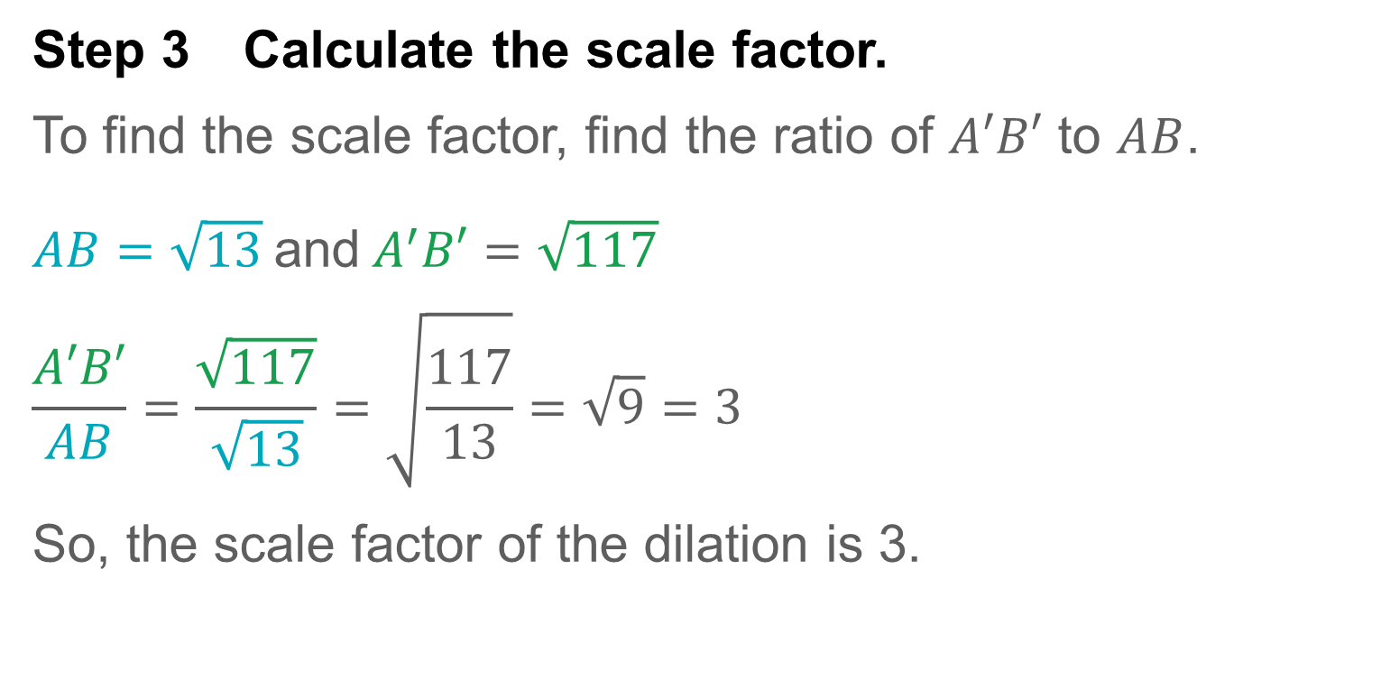
Example 4 Find the Scale Factor of a Dilation
Step 3 Calculate the scale factor.
To find the scale factor, find the ratio of $A′B′$ to $AB$.
$AB=\sqrt{13}$and$A^{′}B′=\sqrt{117}$
$$\frac{A′B′}{AB}=\frac{\sqrt{117}}{\sqrt{13}}=\sqrt{\frac{117}{13}}=\sqrt{9}=3$$
So, the scale factor of the dilation is 3.

Slide 24
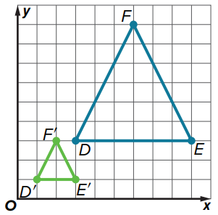
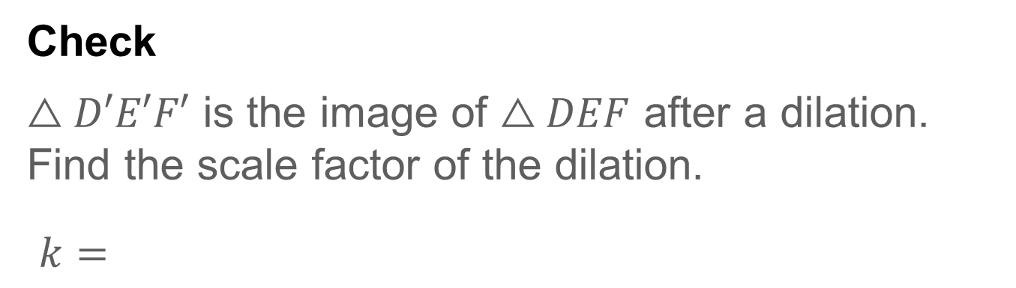
Example 4 Find the Scale Factor of a Dilation
Check
$△D′E′F′$ is the image of $△DEF$ after a dilation. Find the scale factor of the dilation.
$k=$

Slide 25
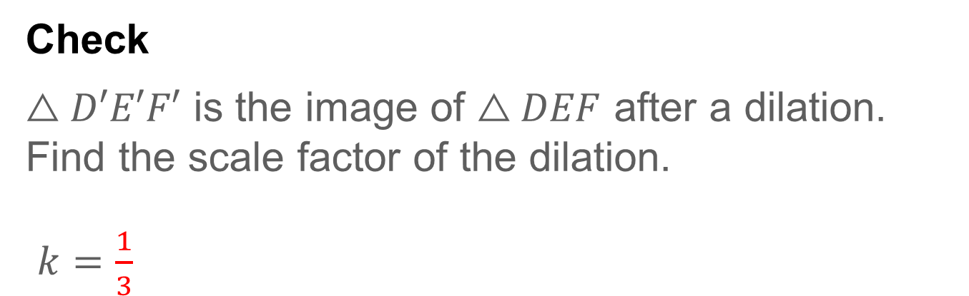
Example 4 Find the Scale Factor of a Dilation
Check
$△D′E′F′$ is the image of $△DEF$ after a dilation. Find the scale factor of the dilation.
$k=\frac{1}{3}$
Notes:
$$\frac{1}{3}$$

Slide 26



MILD (identify + simple coordinate dilations)
Use for: noticing enlargement vs reduction, applying x′ = kx, y′ = ky with easy k.
Qs: 1–4, 6, 8, 13, 15, 20.
Inquiry (2):
• How can you tell quickly if k > 1 (enlargement) or 0 < k < 1 (reduction) just by the picture or numbers?
• If a point is at (x, y), what happens to its distance from the origin after a dilation by k? Explain in one sentence.
MEDIUM (apply scale + compare measures)
Use for: non-unit fractions/decimals, perimeter/scale links, mapping lines under dilations.
Qs: 5, 7, 9, 14, 16, 24, 25.
Inquiry (2):
• If lengths scale by k, how do perimeter and area change? Give the rule for each in words and symbols.
• A line y = mx + b is dilated about the origin by k. When does its equation stay the same form, and what changes when b ≠ 0?
SPICY (reasoning, composition, invariants)
Use for: composing dilations, slopes on segments, properties preserved, always/sometimes/never.
Qs: 22, 23, 26, 27, 28, 30.
Inquiry (2):
• Two dilations with factors k₁ then k₂ are done about the origin. Explain why the single equivalent transformation is a dilation with k = k₁·k₂. When might the center matter?
• Which features are invariant under dilation: angle measure, parallelism, collinearity, midpoint‐ness, slope? Justify briefly for each.

Slide 27
Exit Ticket
Consider the four types of transformations: reflections, translations, rotations, and dilations.
1. How are the transformations alike and different?
2. Which transformations preserve shape and size?
3. Which transformations preserve orientation?
Notes:
Sample answer: All of the transformations represent a mapping of a preimage to an image. Three of the four transformations are isometries.
reflections, translations, and rotations
translations, rotations, and dilations

Slide 28
Exit Ticket
Consider the four types of transformations: reflections, translations, rotations, and dilations.
1. How are the transformations alike and different?
All of the transformations represent a mapping of a preimage to an image. Three of the four transformations are isometries.
2. Which transformations preserve shape and size? reflections, translations, and rotations
3. Which transformations preserve orientation? translations, rotations, and dilations
Notes:
All of the transformations represent a mapping of a preimage to an image. Three of the four transformations are isometries.
reflections, translations, and rotations
translations, rotations, and dilations

